Slide 1
Solar activity & UFOs
Is there a relationship between sunspot activity and UFO sightings?
Amanda Parker
Designer
Ph.D in Psychology (Perceptual Systems)
Teaching Interaction Design as well
Notes:
This project explores whether solar activity (sunspot observations) can predict UFO reports or other light/percpetual phenomena as it does the aurora.
Presentation tips throughout…
Career tips +
Business context
UX/interface design
First, introduce yourself

Slide 2
T-shaped careers
General skills
Deep skill
Notes:
Career advice bit
T-shaped careers
Tim Brown IDEO
Can talk about myself:
My deep skill is interfaces
Ask audience if (or how) t-model applies to them?

Slide 3
T-model
General skills
Deep skill
Notes:
Career advice bit
Ask audience if (or how) t-model applies to them?

Slide 4
Notes:
Data scientist infographic
Need to be competent across all areas, but specialise
Importance of team work

Slide 5
Back to UFOs
http://midnightinthedesert.com/ufo-sightings-peak-summer/
Notes:
Given my perceptual systems focus, I’m interested in perceptual phenomena, like illusions, hallucinations and things like UFO reports and reports of other light phenomena…
There is reason to believe that UFO reports can be attributed to natural phenomena.
UFO reports peak in the summer, when the sky is clearer : http://midnightinthedesert.com/ufo-sightings-peak-summer/

Slide 6
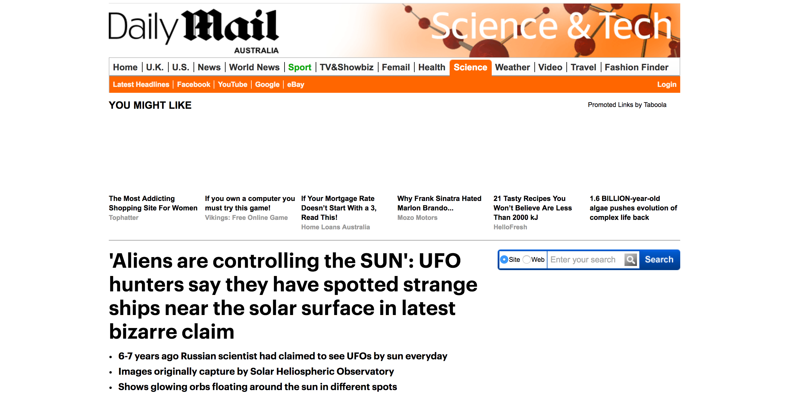
Notes:
Numerous pop culture articles on the internet link UFO reports to activity from the sun. The visual appearance of sunspots shares similarities with sun-linked UFO reports (for example seeing a number of black disks 'fly' across the sun, or this example).

Slide 7
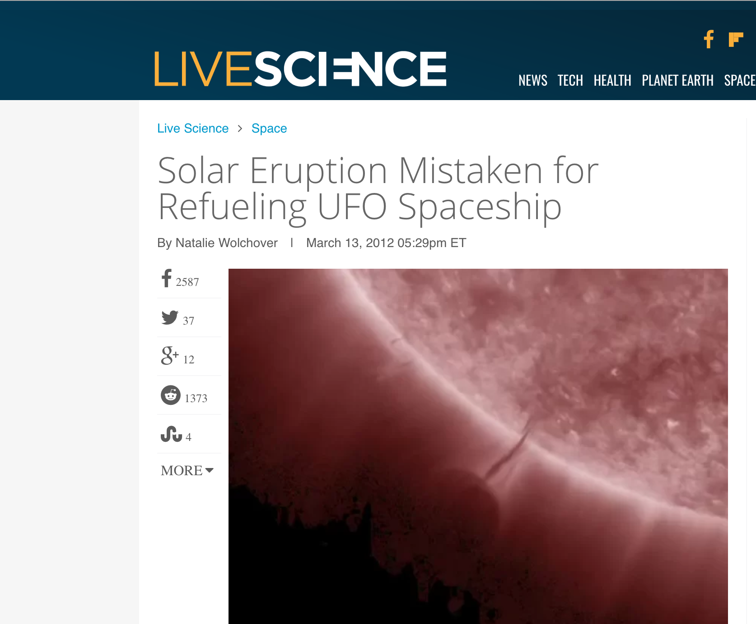
Notes:
, or this example
The academic literature contains some references to a correlation between solar activity and UFO reports, but there is sparse recent research.
We already know: Atmospheric and solar conditions are linked to the aurora
Inductive reasoning has its place in the scientific method. (from the singular observation to the general). Scientists use it to form hypotheses and theories. Deductive reasoning (then) allows them to apply the theories to specific situations (from the general to the singular)
This part is what I call ‘Exploratory Data Analysis’ or simply exploring data. Reading, background research. You look at the data available and the wider context (domain) to form a hypothesis. Once you have an idea or theory of what might be going on (in the data), you then test it, or in DS try to model that theory and see if it can predict the observed pattern with high accuracy.

Slide 8
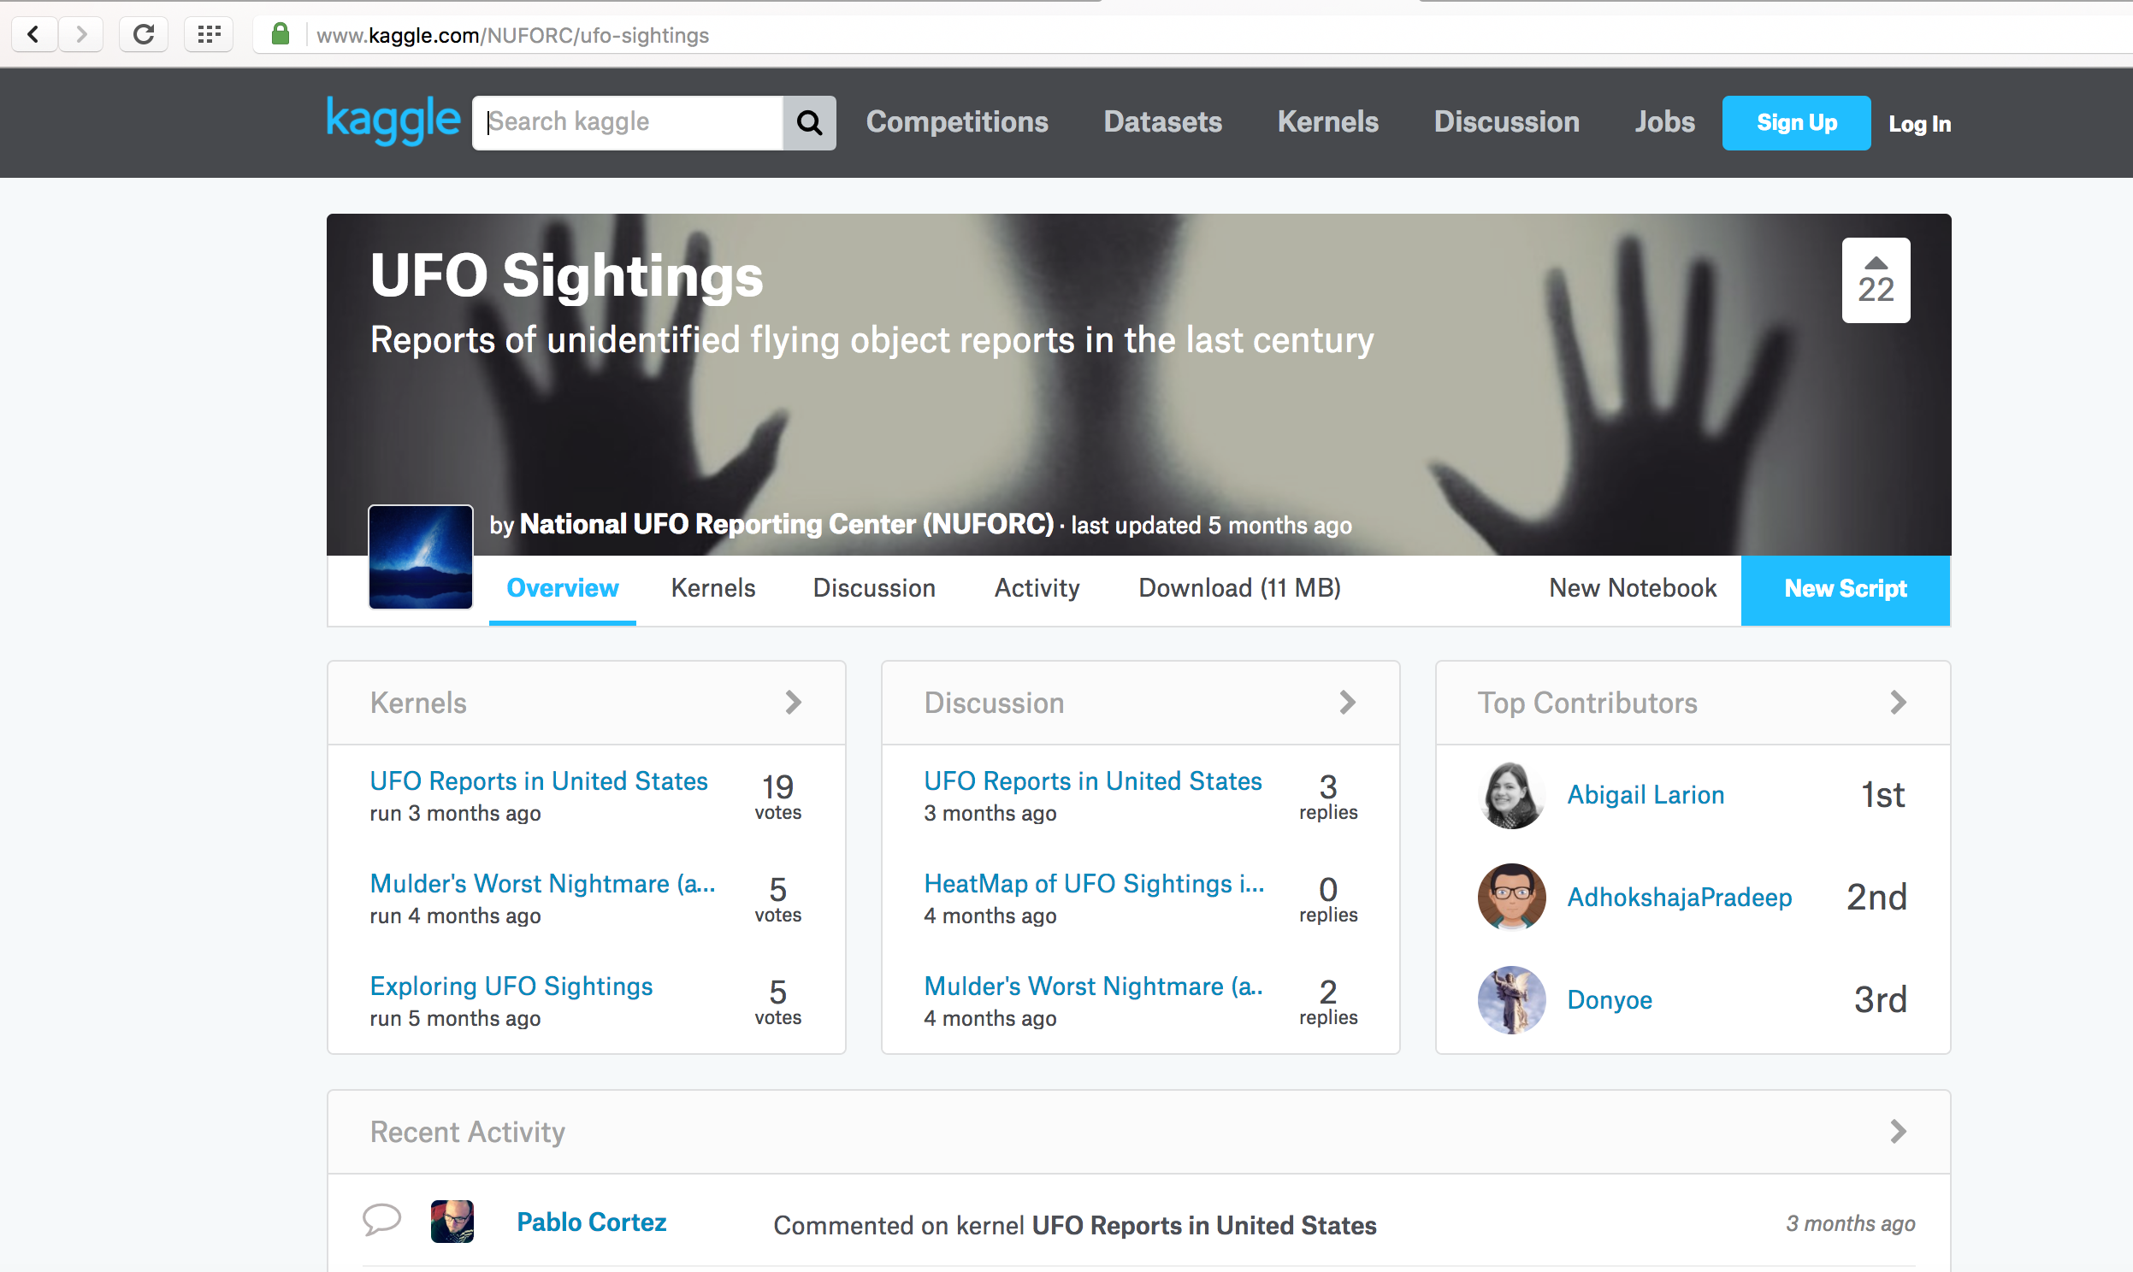
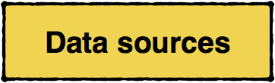
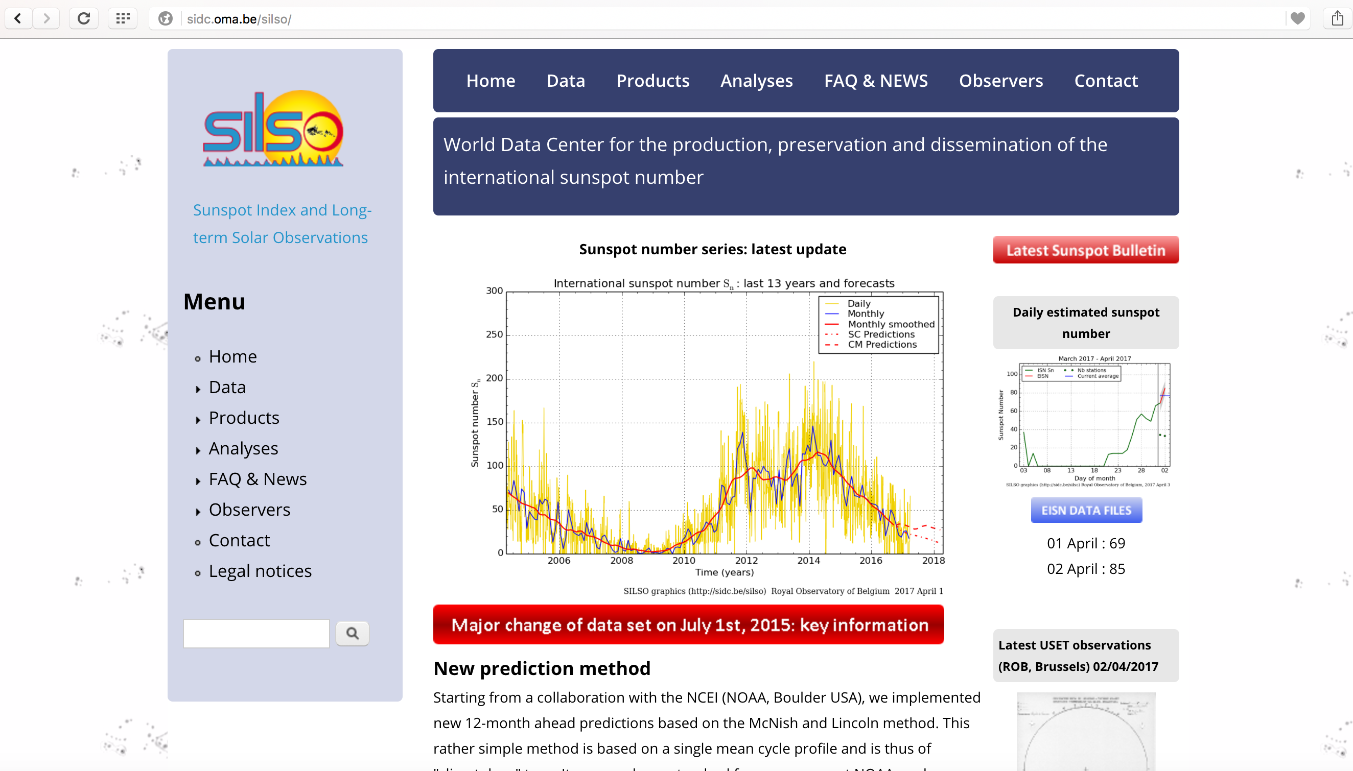
Notes:
This analysis revisits the link between solar activity and UFO reports with a more recent (and larger) UFO data set than used previously along with sunspot observation data from the Royal Observatory of Belgium website http://sidc.oma.be/silso/. The UFO data analysed was mostly collected through an online reporting database NUFORC.org and covers the period of the internet (1996-onwards) increasing report rates. Data older than the nuforc.org website registration in 2001 was presumably added manually.
The value of intersecting data sets

Slide 9
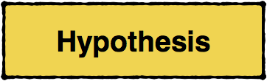
The theory - UFO reports are actually mistaken sunspot observations
If: UFO reports are mistaken sunspot observations
Then: Sunspot observation time series will predict UFO report time series
If our theory ____ is true,
we predict _____ will happen
Notes:
Industry applications
For UX/UI research
Make theories based on a sample of customer behaviour (e.g. 5-10 usability tests)
Can then test these theories in the customers behaviour (inferred via data) with the interface en mass
For marketing
Market research
Monitor campaign metrics
Others
etc

Slide 10

1. Data formatting
2. Signal coherence
3. Time series decomposition
4. Granger causality test
5. ARIMA
-Can one series forecast the other?
Notes:
Knowing which statistical tests to use and when,
as important as knowing how to perform them

Slide 11
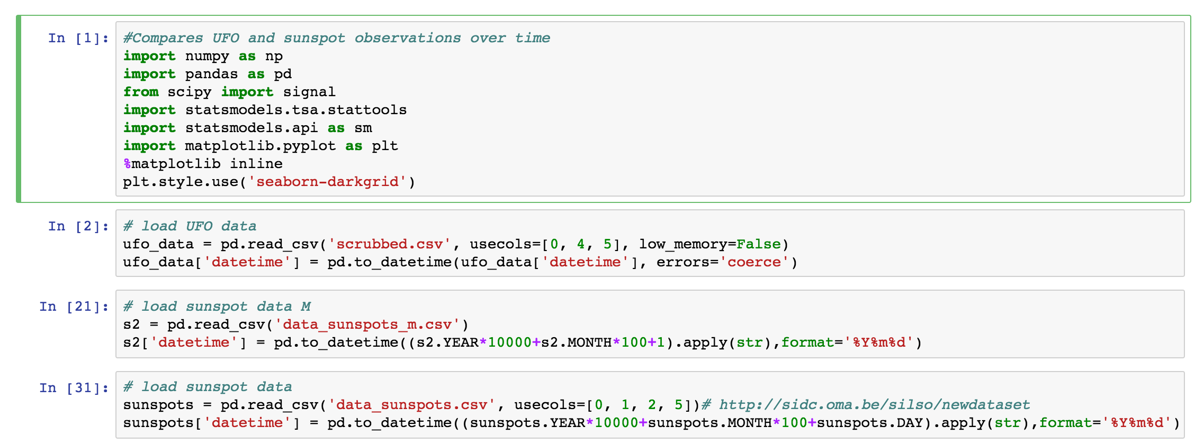
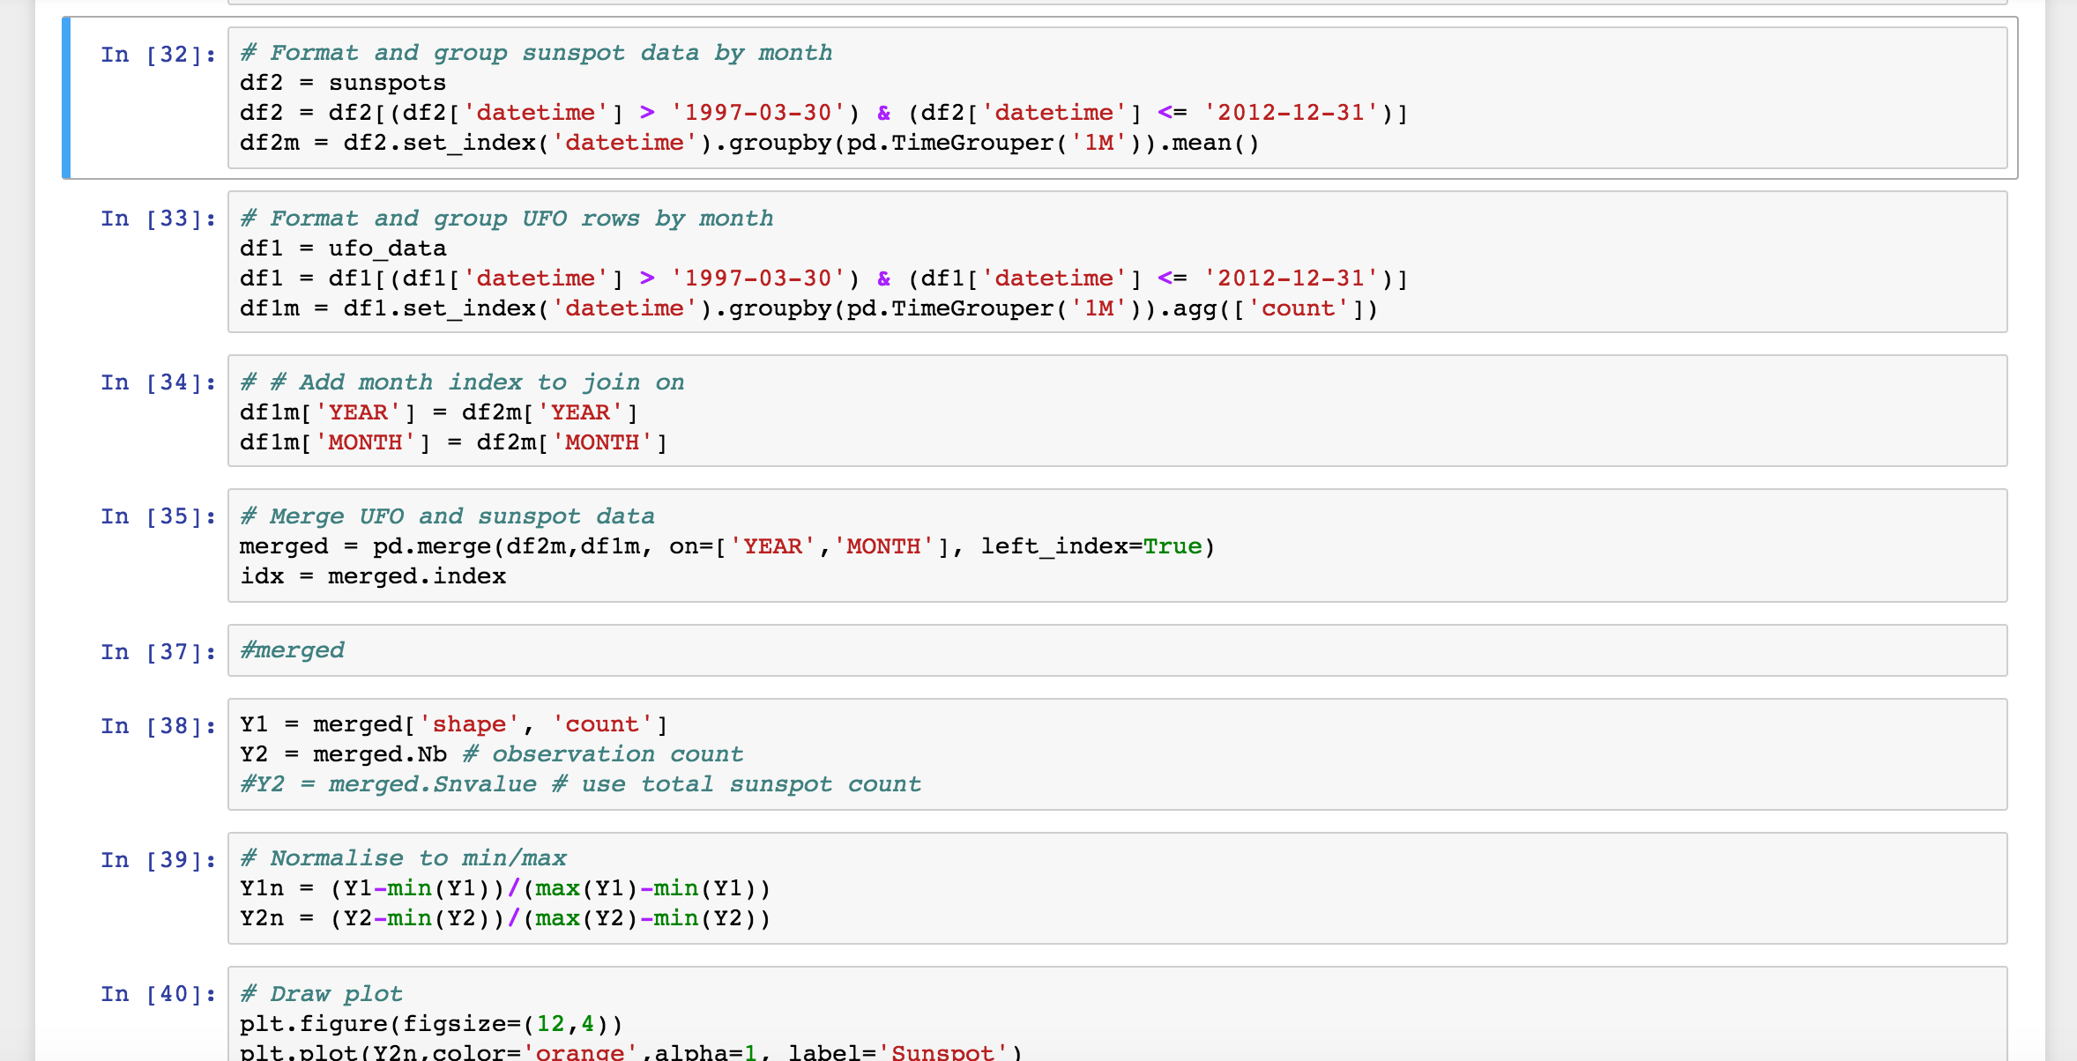
Libraries
Load data
Format data

Slide 12
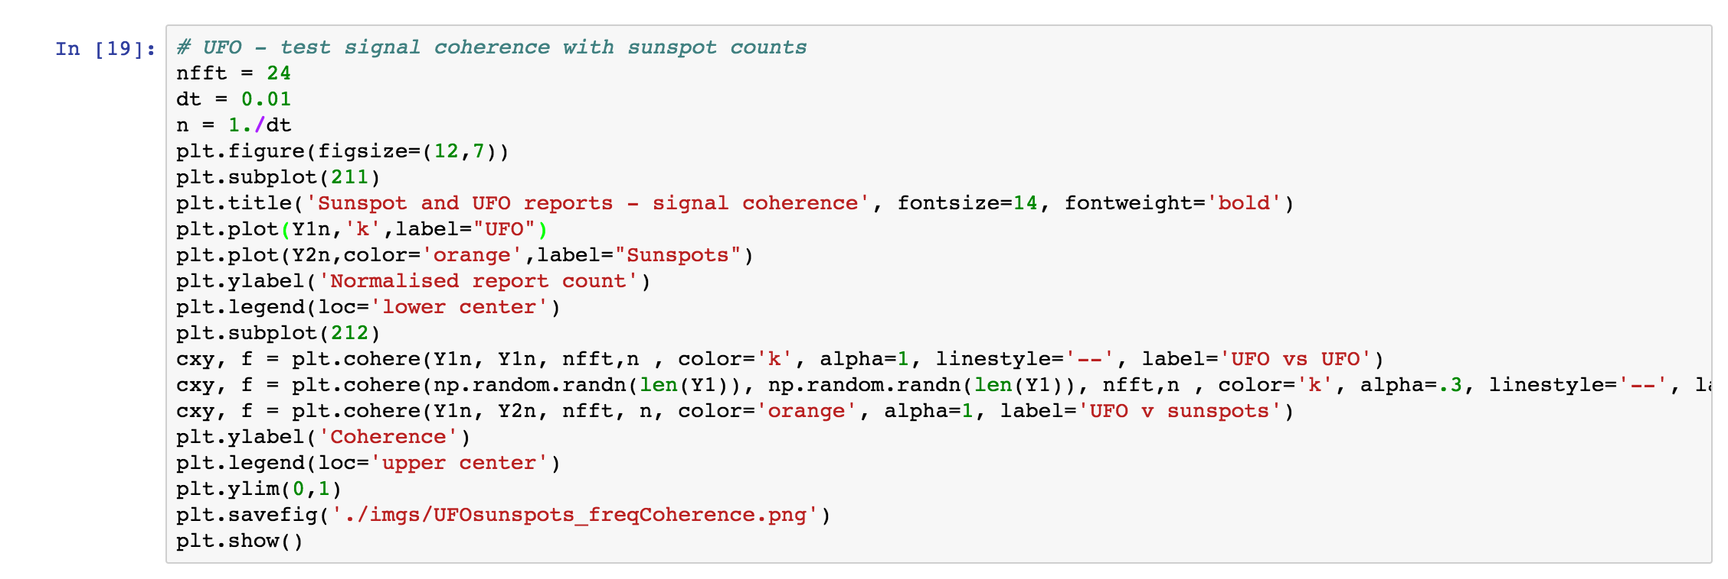
Signal coherence
Notes:
First tested signal coherence between the two time series
Only the observation counts shared a signal with the UFO data
the solar activity metric did not.

Slide 13
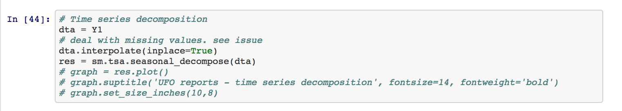
Timeseries
decomposition
Notes:
Note: Couldn’t do the decomposition when dataset aggregated by day
as there were lots of missing values in the UFO data
Had to aggregate the data by month.
Trend: Influence of internet on UFO report archiving? solar recording more stable.

Slide 14
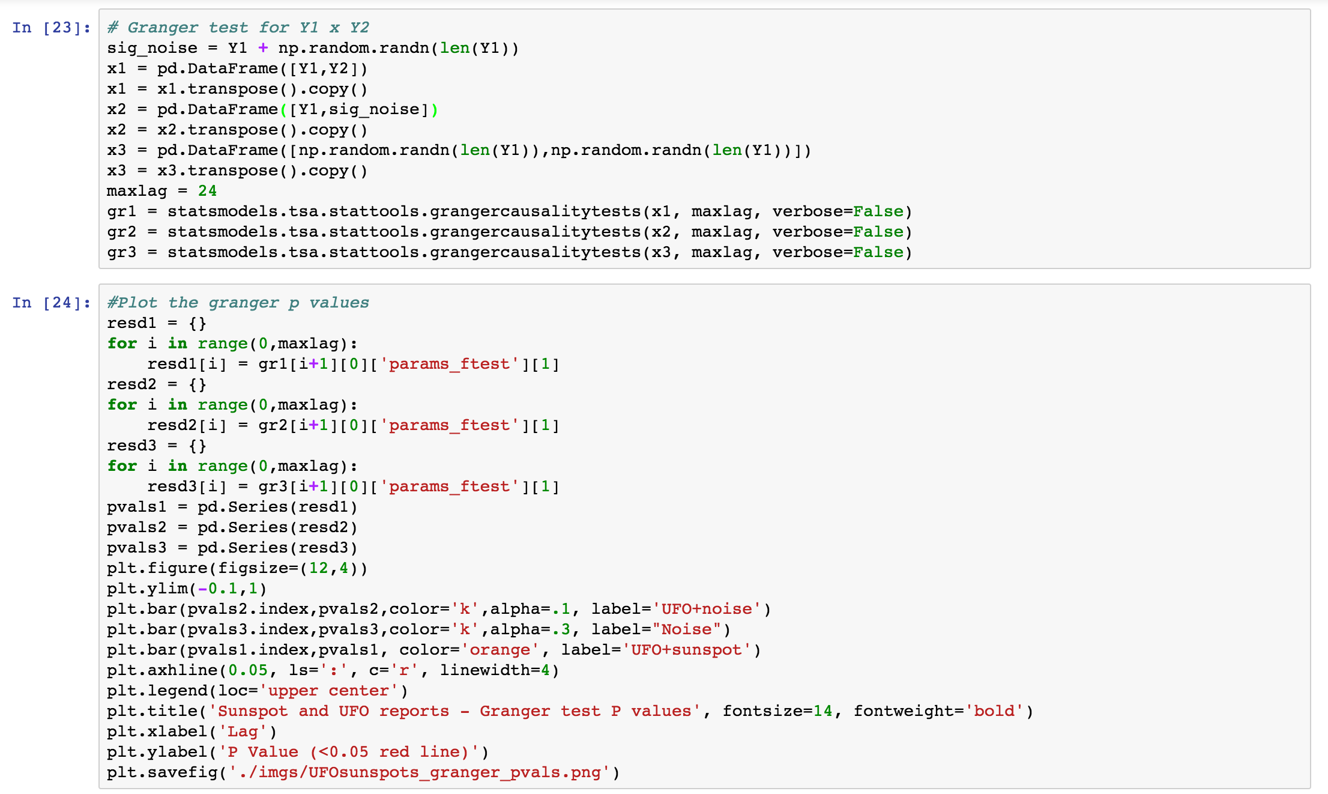
Granger test

Slide 15

Only the sunspot observations (count) shared signal with the UFO reports’ - not the sunspot activity metric
Shared signal between seasonal beyond 12 months, and residual up to 5 months (but not trend)
Trend: Influence of internet on UFO report archiving, solar recording more stable.
Notes:
Need longer data set to pick up on the longer solar cycle

Slide 16

Notes:
Didn’t finish the forecasting (predictive modelling)
No significant relationship for time-series trend
Need longer data set to detect 10 year solar cycle
Atmospheric visibility
Strong seasonal component like previously reported (sig cohr lag up to 12 mths) - more reports of both in Summer.
What about the residual test? - Looks like sunspot observations are predictive separately up to 5 months lag. Could delve into geolocation to explore further.
UFO sighting trend probably effected by growth of internet (increased reporting)
Sunspot trend is more cyclical, and stable recording over time.
Solar activity
Maybe the solar activity is not really important if poor visibility means you cant see these fluctuations at all under the seasonal pattern - solar cycle is quite long - may need to test with a longer time series.
Conclusion
Need to do predictive modelling to determine how much sunspots might contribute to UfO reports. Common sense - there are lots of weird, wonderful natural light phenomena, sightings of those probably play a large part too. Can’t rule out other sources of UFO sightings.
New theory: All natural light phenomena predicts UFO sightings
Next steps: UFO sighting shape (type) linked to light phenomenon type?
Audience: Do you have any UFO theories?

